Slide 1
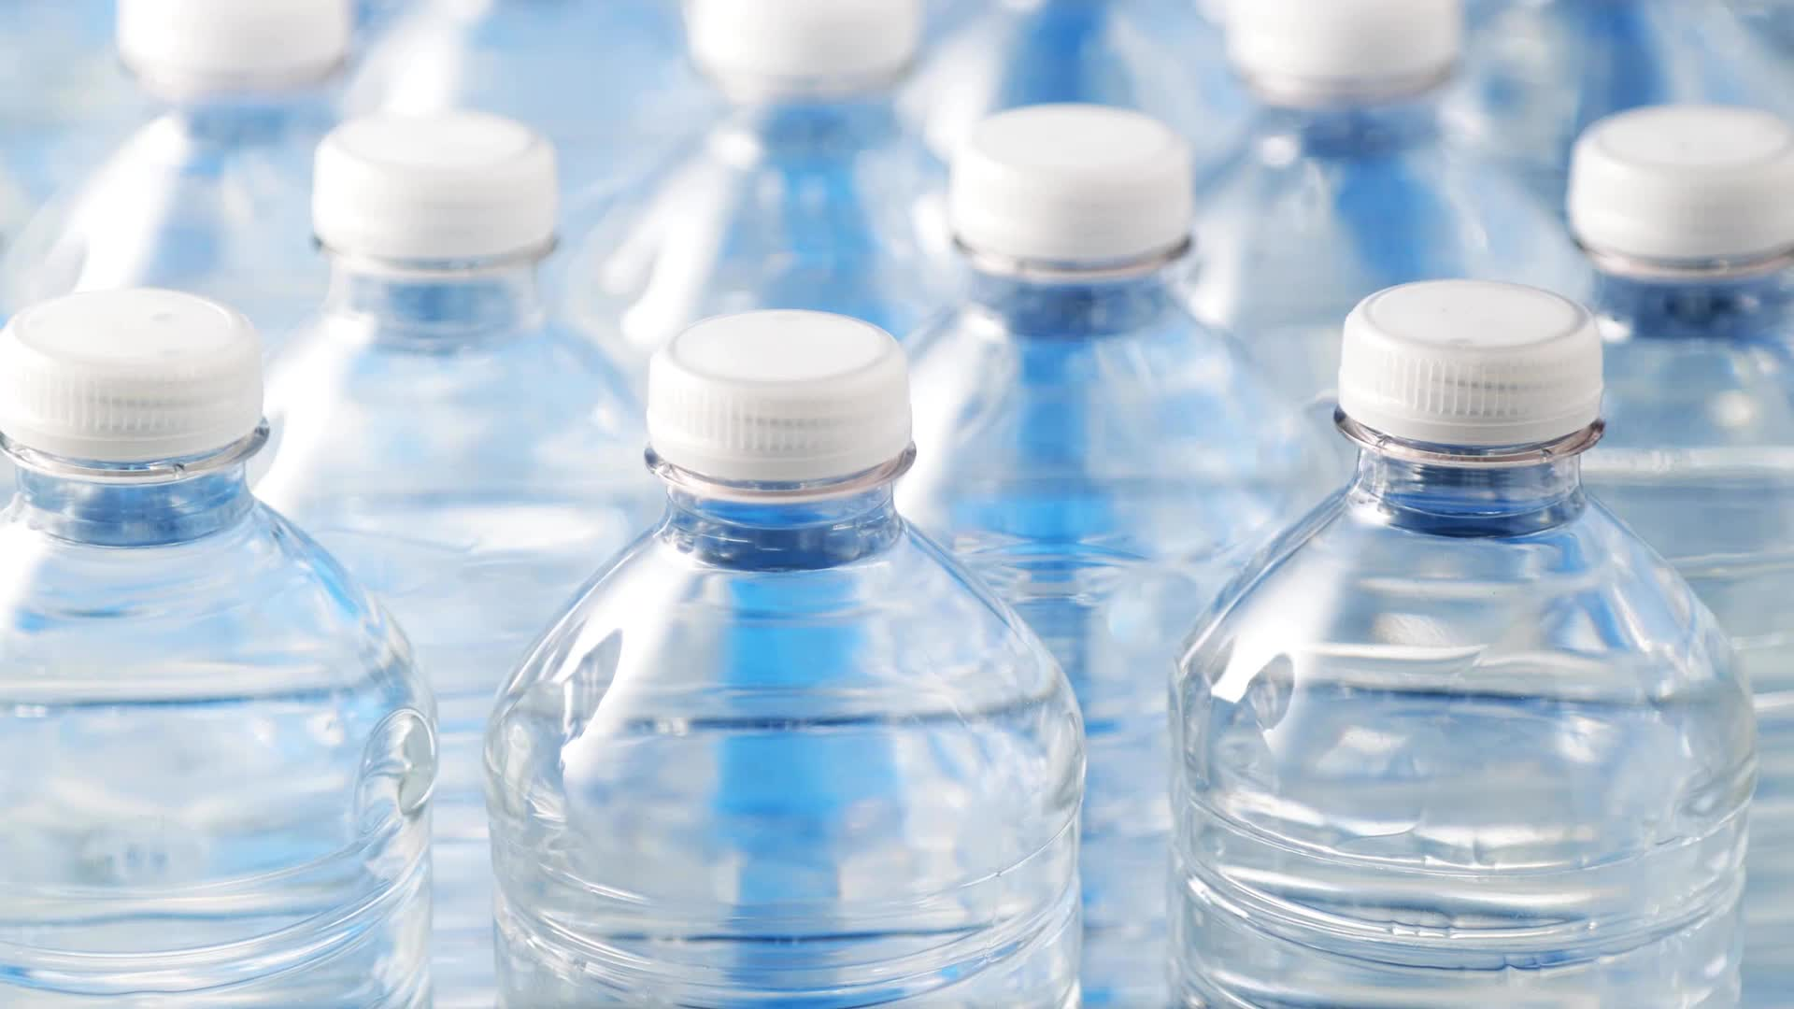
Water Quality Classification Using Machine Learning

Slide 2

Abstract
Water quality assessment is essential for ensuring safe drinking water and monitoring environmental health. Traditional testing methods are time-consuming and costly. This project leverages Artificial Intelligence (AI) and Machine Learning (ML) to classify water quality based on parameters like pH, turbidity, dissolved oxygen (DO), total dissolved solids (TDS), and conductivity. The system utilizes supervised learning algorithms such as Random Forest, SVM, and Neural Networks to predict water quality categories (e.g., Safe, Moderate, Polluted). Real-time data from IoT sensors can be integrated to enhance accuracy. By automating water quality assessment, this AI/ML approach improves efficiency, accuracy, and decision-making for water resource management.

Slide 3
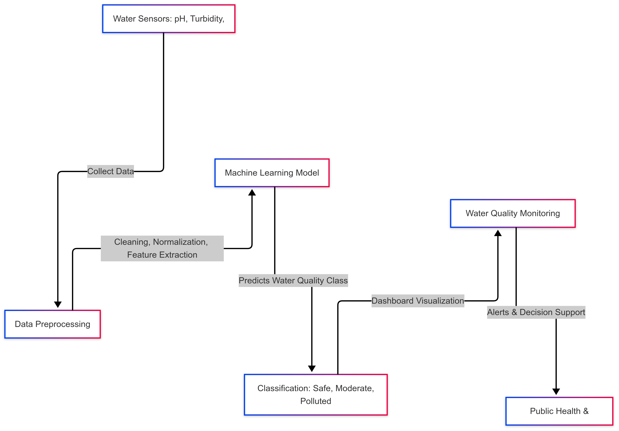
Block Diagram

Slide 4
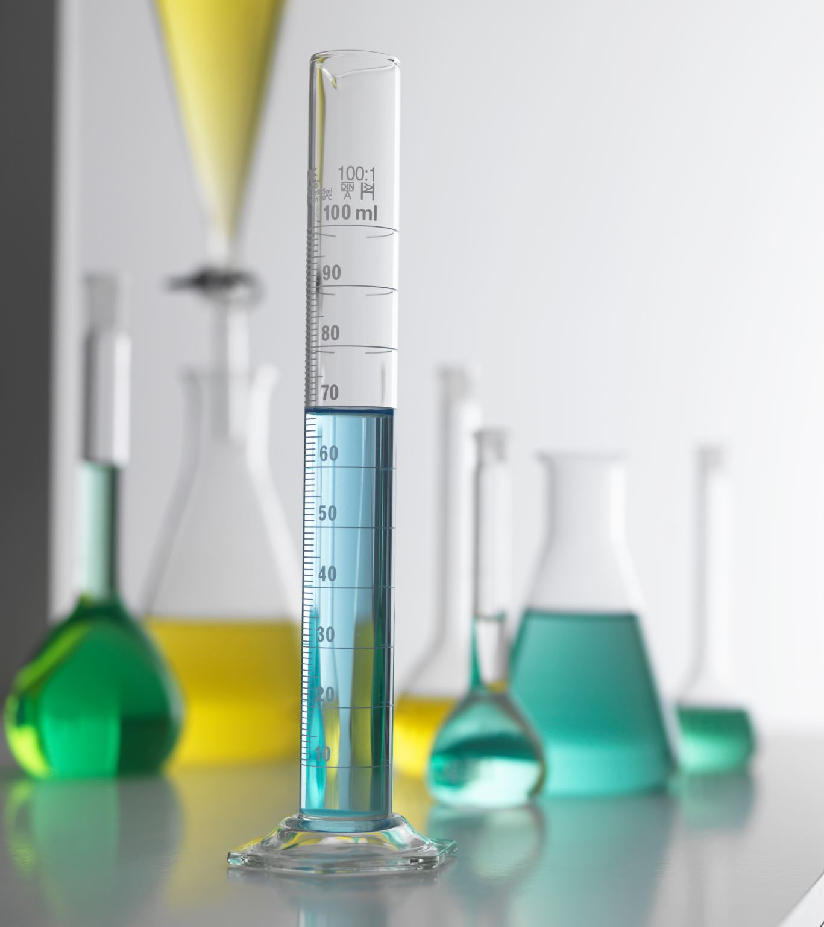
Existing System
Traditional water quality assessment relies on manual testing methods, including laboratory analysis of water samples.
Testing requires chemical reagents, field kits, and expert supervision, leading to delays in results.
Water quality classification is done based on threshold values of physical and chemical properties like pH, TDS, turbidity, and dissolved oxygen.
Data collection is often sporadic and lacks real-time monitoring capabilities.

Slide 5
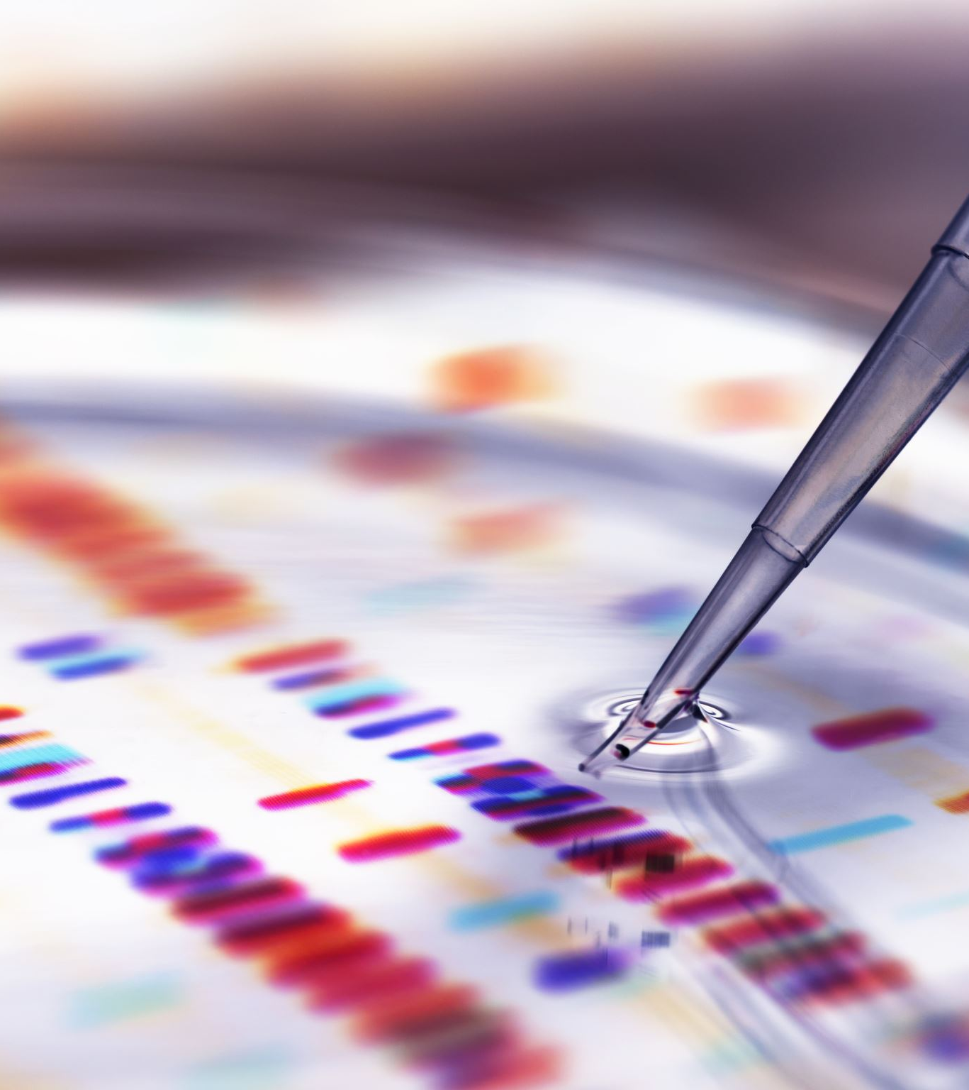
Disadvantages of the Existing System
Time-consuming – Manual water testing takes hours or even days to complete.
Expensive – Requires specialized equipment and skilled professionals for accurate results.
Limited scalability – Hard to implement large-scale monitoring due to cost and logistics.
Human error – Manual testing can lead to inconsistencies in results.
Lack of real-time monitoring – Inability to detect sudden water quality deterioration.

Slide 6
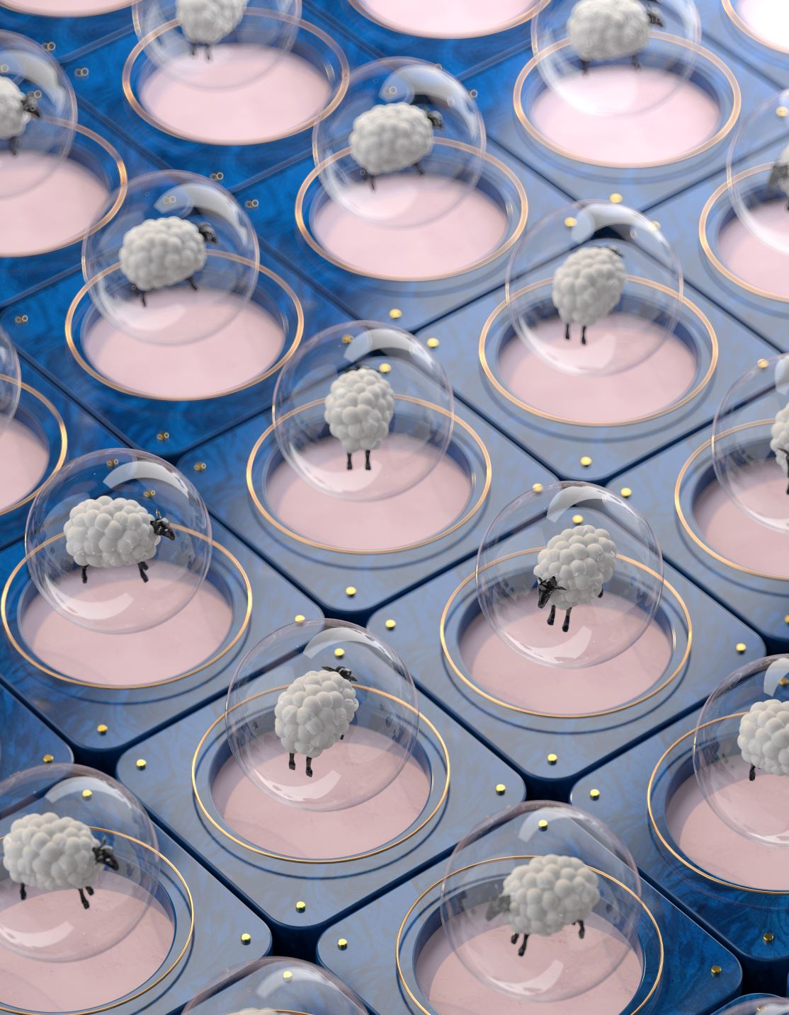
Proposed System
The proposed system uses AI and Machine Learning to automate water quality classification.
Sensors collect real-time data on pH, turbidity, DO, TDS, conductivity, and other parameters.
Machine Learning models (e.g., Random Forest, SVM, Neural Networks) classify water as Safe, Moderate, or Polluted based on historical and real-time data.
The system integrates IoT sensors for continuous monitoring and cloud-based analytics for remote access.
Predictive analytics help identify contamination trends and prevent waterborne diseases.

Slide 7
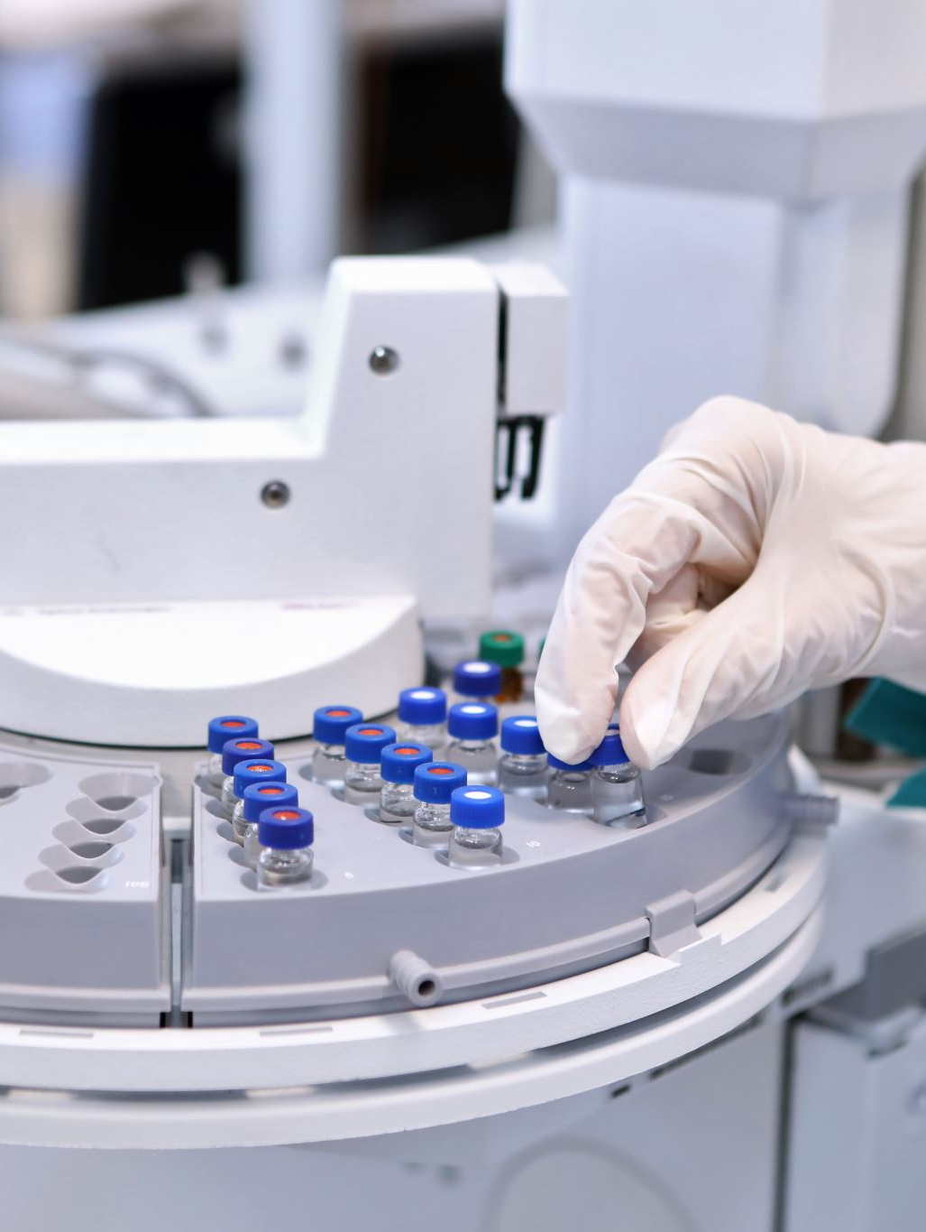
Advantages of the Proposed System
✅ Real-time monitoring – Continuous tracking of water quality for instant analysis.
✅ Faster decision-making – Automated classification reduces testing time from hours to seconds.
✅ Cost-effective – Eliminates the need for expensive lab tests and reduces human intervention.
✅ High accuracy – Machine learning models improve precision and reliability.
✅ Scalability – Can be deployed in municipal water supplies, industries, and remote areas.
✅ Early contamination detection – AI predicts and alerts authorities about potential water pollution threats.

Slide 8
6. Environmental Requirements
The environmental requirements for this water quality classification system include:
1. Hardware Requirements
Computational Hardware: A system with a minimum of 8GB RAM, i5 processor, and GPU (optional for deep learning models)
Cloud Storage: To store and process water quality data
2. Software Requirements
Operating System: Windows, macOS, or Linux
Programming Language: Python (with ML libraries)
Machine Learning Libraries: NumPy, Pandas, Scikit-learn, TensorFlow, Matplotlib
Database: SQL, Firebase, or NoSQL databases to store historical data
3. Network Requirements
Internet Connection: Required for cloud-based data storage and model training
API Access: If integrating real-time data collection from IoT sensors

Slide 9
7. Introduction
Water contamination is a significant global issue, affecting public health, agriculture, and ecosystems. Traditional methods for water quality assessment are time-consuming and expensive. This project proposes a Machine Learning-based system to classify water as Safe or Polluted based on chemical and physical properties.
Machine learning algorithms analyze historical data and predict water safety with high accuracy, making it a cost-effective and scalable solution. The project aims to integrate AI with real-time monitoring systems to automate water quality classification.

Slide 10

8. Machine Learning in Water Quality Analysis
Machine Learning (ML) provides an automated and data-driven approach to classify water quality.
Types of Machine Learning Used
Supervised Learning
Uses labeled datasets where the model learns from past water quality data.
Algorithms: Random Forest, SVM, Neural Networks.

Slide 11

9. Preparing the Dataset
The dataset is crucial for training ML models. The steps involved include:
Data Collection: Sources like Kaggle, government water databases, or IoT sensors.
Feature Selection: Important parameters include pH, turbidity, chloramine, sulfate, TDS.
Handling Missing Data: Using mean imputation, median, or mode filling.
Data Normalization: Scaling values for consistent input.
Splitting the Dataset: 80% for training, 20% for testing.

Slide 12
10. Literature Survey (IEEE Papers Analysis)
Author | Title | Year
X. Zhang | AI in Water Quality Prediction | 2021
Y. Liu | Machine Learning for Water Contamination Analysis | 2020
R. Kumar | Deep Learning for Smart Water Monitoring | 2019
These papers analyze various AI techniques for water quality monitoring and compare traditional vs AI-based approaches.

Slide 13
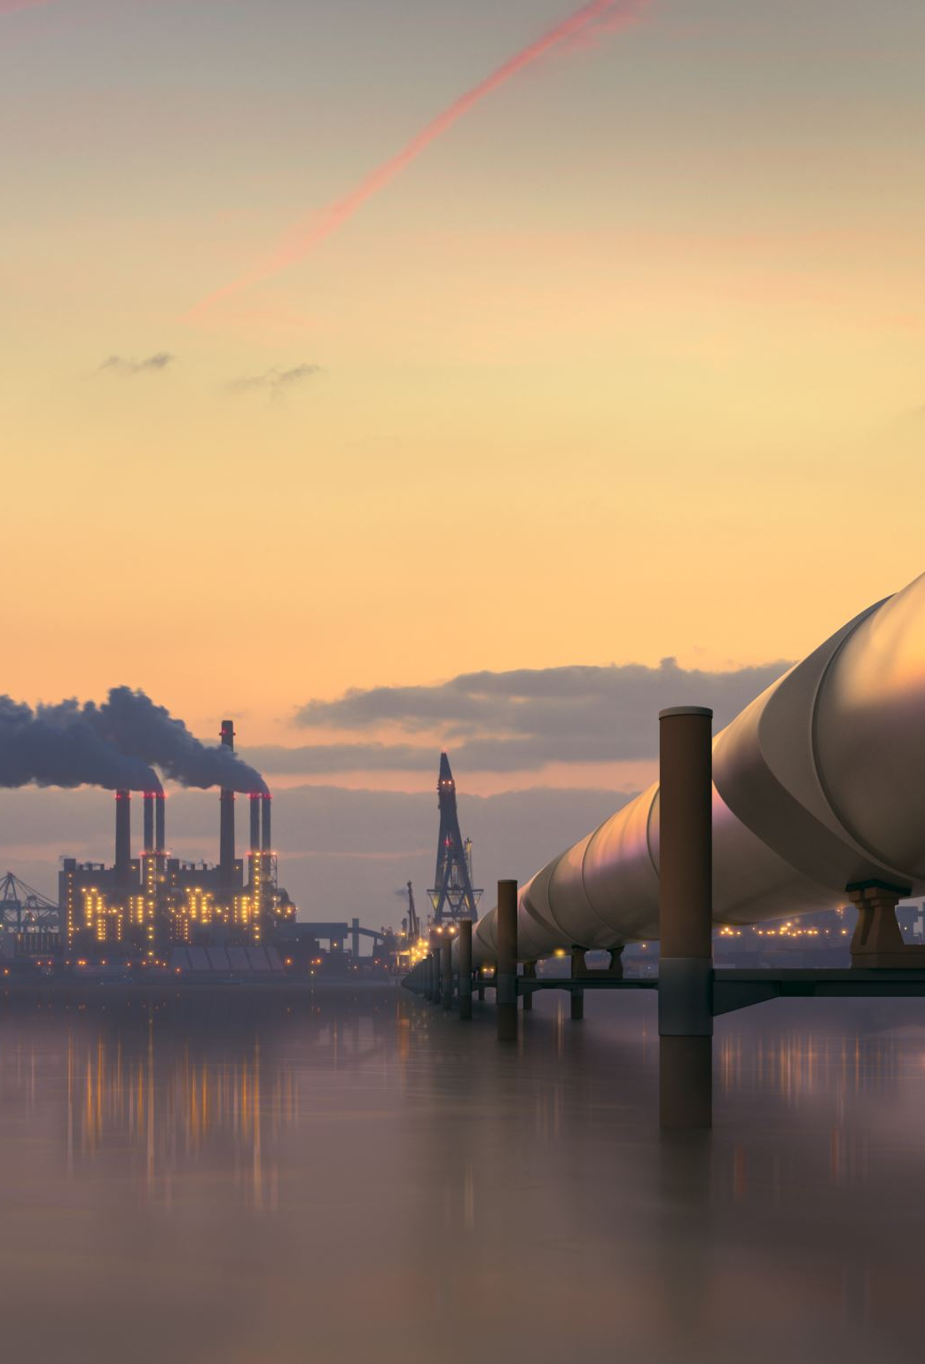
11. Objectives
Develop an ML model to classify water as Safe or Polluted.
Compare different ML algorithms for accuracy.
Automate real-time water quality prediction.
12. Scope of the Project
Smart Cities: Integrated with IoT-based real-time monitoring.
Government Agencies: Helps in pollution control.
Public Health: Ensures safe drinking water standards.

Slide 14
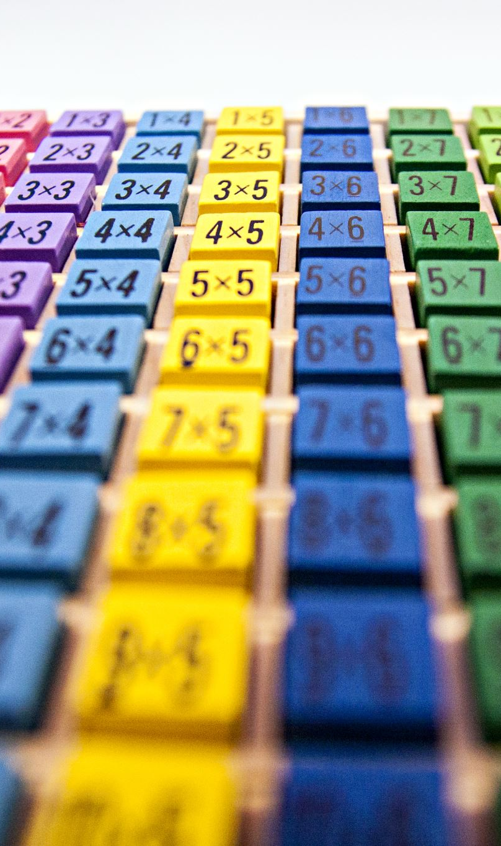
13. List of Modules
Data Collection Module – Gathers water quality parameters.
Data Preprocessing Module – Cleans and normalizes data.
Feature Selection Module – Identifies the most important variables.
Model Training Module – Trains ML algorithms.
Prediction Module – Classifies water as Safe or Polluted.
Evaluation Module – Compares models for best accuracy.

Slide 15
14. Python for Implementation
Python is used due to its rich ecosystem of ML libraries.
NumPy, Pandas – Data handling
Scikit-learn – Machine learning models
Matplotlib, Seaborn – Data visualization
TensorFlow/Keras – Deep learning (if needed)

Slide 16

15. Module Description
✔ Data Collection – Sources like Kaggle, IoT sensors, and open datasets. ✔ Preprocessing – Handling missing values and scaling data. ✔ Model Selection – Training Random Forest, SVM, and Neural Networks. ✔ Prediction & Evaluation – Identifying the best-performing model.

Slide 17
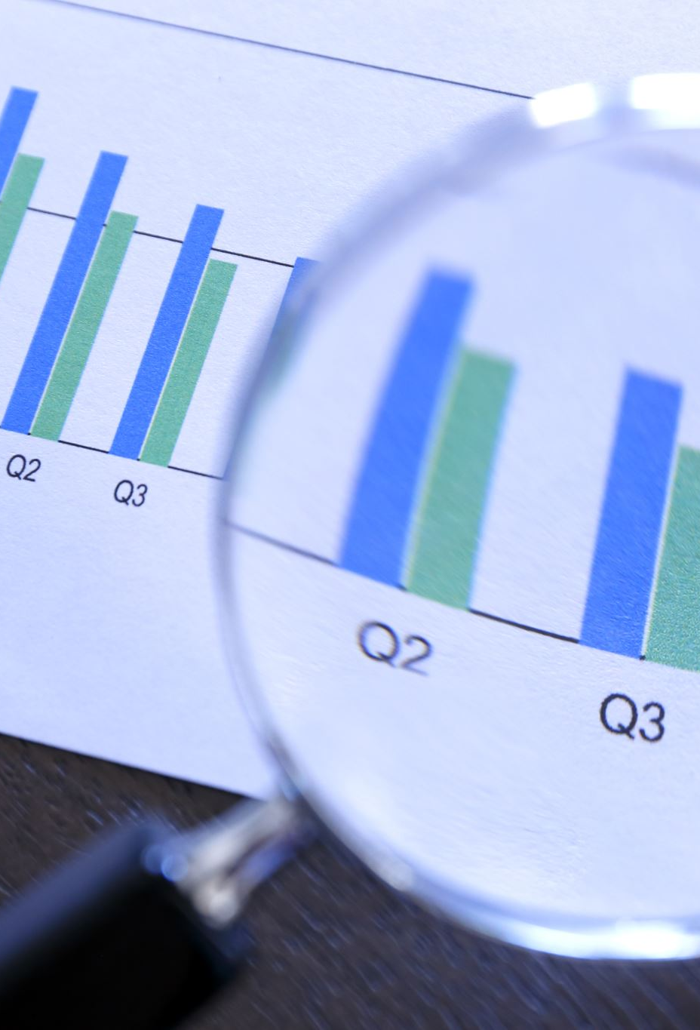
16. Data Validation & Cleaning Process
Remove Null Values: Fill missing values using statistical methods.
Handle Outliers: Detect and remove anomalies.
Convert Data Types: Ensure numerical values are in correct formats.

Slide 18

17. Exploratory Data Analysis (EDA) & Visualization
Heatmaps – Show correlation between features.
Boxplots – Identify outliers.
Scatter Plots – Display data distribution.

Slide 19
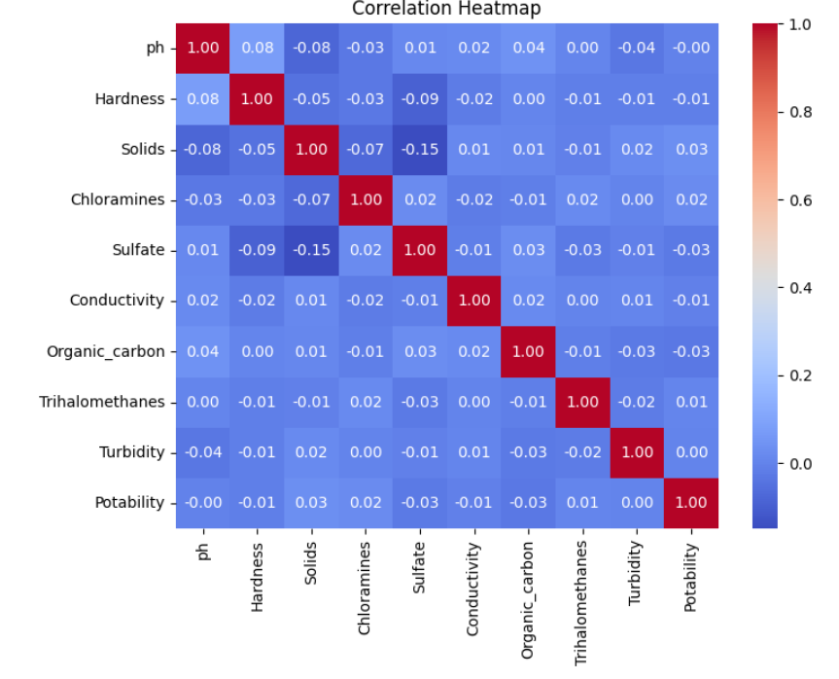
Heatmap

Slide 20
18. Comparing Algorithm Performance
Algorithm | Accuracy | Precision | Recall
Random Forest | 92% | 90% | 88%
SVM | 89% | 87% | 85%
Neural Network | 94% | 92% | 91%
Random Forest and Neural Networks give the best results.

Slide 21

19. Algorithm Explanation
Random Forest: Uses multiple decision trees for high accuracy.
SVM (Support Vector Machine): Works well with smaller datasets.
Neural Networks: Highly accurate but computationally expensive.

Slide 22
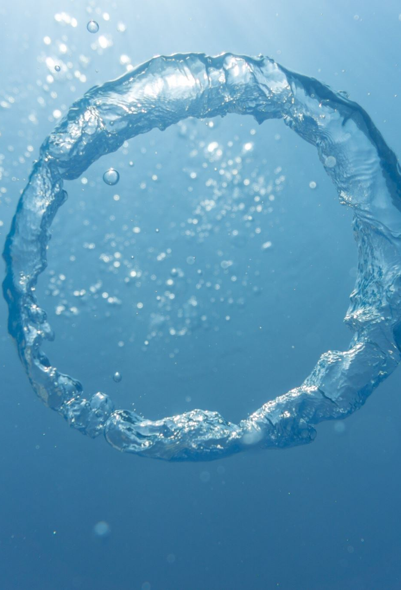
20. Conclusion
✔ AI-based water classification is faster and more accurate than traditional methods. ✔ Neural Networks achieved the highest accuracy (94%). ✔ Machine Learning enables real-time water monitoring, reducing manual errors.

Slide 23
21. Future Work
IoT Integration – Real-time water quality monitoring.
Deep Learning Models – Improve accuracy with CNNs or RNNs.
Mobile App Development – Allow users to check water quality via smartphone.

